Slide 1

Business

Slide 2
Definition
business is the practice of making one's living by engaging in commerce

Slide 3
Definition
commerce is the activity of buying and selling, especially on a large scale

Slide 4
Business
commerce is a win-win deal and is necessary to keep goods and services flowing

Slide 5
Business
studies show that the business mindset makes people more likely to lie and commit crimes

Slide 6
Business
rules are designed to prevent crimes

Slide 7
Definition
The deterrence hypothesis is the idea that crime can be deterred through changes in the costs or benefits derived from committing crime

Slide 8
Business
One study (“A Fine is a Price”) had interesting results regarding the deterrence hypothesis
“A Fine is a Price” can be found here: https://rady.ucsd.edu/faculty/directory/gneezy/pub/docs/fine.pdf

Slide 9
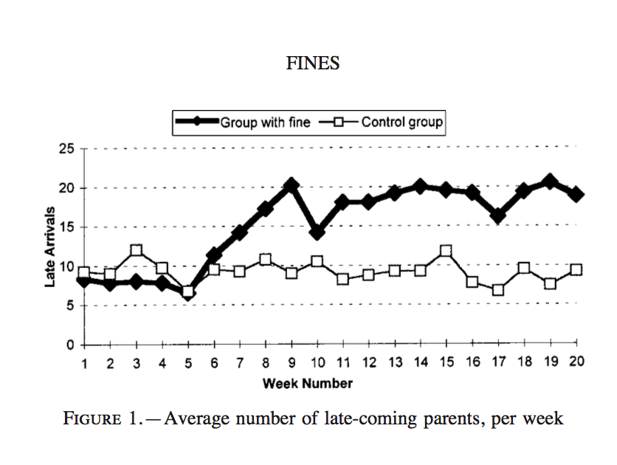
“A Fine is a Price”
From week 4 to week 16, a fine of $3 was imposed for each late pickup in a group of 6 daycare centers.
Fine
Notes:
In “A Fine is a Price” 10 daycare centers reported data to the researchers. The daycare centers monitored the number of times parents arrived late to pick up a child per week. For the first four weeks, there was no explicit penalty for picking up a child late. But starting at week 4, a fine of about $3 was imposed for each late pickup. The fine was automatically tallied into the monthly bill. This graph shows the group with the fine as the darker line. The rate of late pickups in this group seems to have doubled because of the fine. Additionally, when the fine was removed at week 16, the rate of late pickups did not regress toward its initial value. The results of this study are contrary to expectations since a fine would typically exist to prevent people from committing an undesirable behavior such as picking up a child late.

Slide 10
“A Fine is a Price”
Incomplete contract
Fine
Notes:
Before the fine was imposed, the contract between the parents and the daycare centers was incomplete regarding late pickups, so parents had to make up the cost of coming late themselves. The daycare center could have kicked out the child for coming late.

Slide 11
“A Fine is a Price”
Incomplete contract
When a price was set, it became an economic affair
Fine
Notes:
Once the fine was set, the parents knew that the child would not be kicked out for coming late. Late pickups became a service offered for a price. Parents engaged in the economic affair of buying late pickups.

Slide 12
entrepreneurship is the process of designing, launching, and running a new business
Definition

Slide 13
Through much perseverance and trial and error, the entrepreneur produces something of value. -Steven Hicks

